Slide 1

TRAVEL VIBES
PREPARED BY:- MITANSH GOR-IU1949150035
MANAV S PATEL-IU1941050052
Guided by:- Mr.Hiren Mer
CE Department,IITE,Indus University

Slide 2
OUTLINES :-
TRAVEL VIBES IS A TRAVEL SERVICES WEBPAGE WHICH OFFERS SERVICES SUCH AS TRAVEL RESERVATIONS, ACCOMODATION , CAR HIRE , ACCOUNTING SERVICES, ETC.WE ALSO OFFERS MIX TRAVEL PACKAGES WHICH INCLUDES FLIGHT BOOKING, HOTEL BOOKING, HOTEL TRANSFERS , ADVENTURES , SIGHT SEEING AND MANY MORE.

Slide 3

Introduction to the Project
Travel Agents sell dreams. Everyone dreams about going and doing something and a travel agent can make it happen. It is also very rewarding when customers come home and thank you and tell you how great it was.
Half of all independent new businesses fail within their first two years whilst 90% of franchise businesses become profitable in that same period of time.”

Slide 4

Hardware /software details :-
VISUAL STUDIO CODE
XAMPP SERVER
GOOGLE CHROME , MIRO
GITHUB , GIT
HTML , CSS , BOOTSTRAP , RESPONSIVE CSS
PHP , JAVASCRIPT , JQUERY , AJAX
MySQL

Slide 5
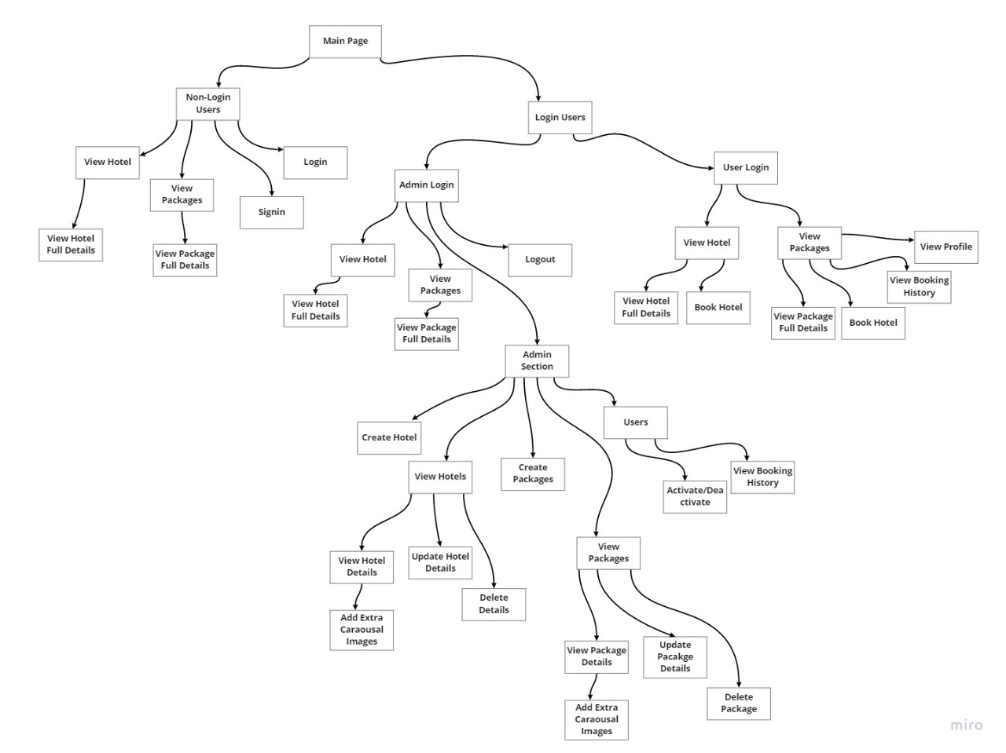
Flow of the project using Miro :-

Slide 6
Functionalities/Features :-
USER
ADMIN
USER PROFILE
VIEW HOTELS AND ITS DETAILS
BOOK HOTELS
VIEW PACKAGES AND ITS DETAILS
BOOK PACKAGES
BOOKING HISTORY
CRUD HOTEL
ADD EXTRA CAROUSAL IMAGES OF HOTELS
CRUD PACKAGES
ADD EXTRA CAROUSAL IMAGES OF PACKAGES
VIEW ALL USERS AND THEIR ACTIVITY
ACTIVATE AND DE-ACTIVATE USER

Slide 7
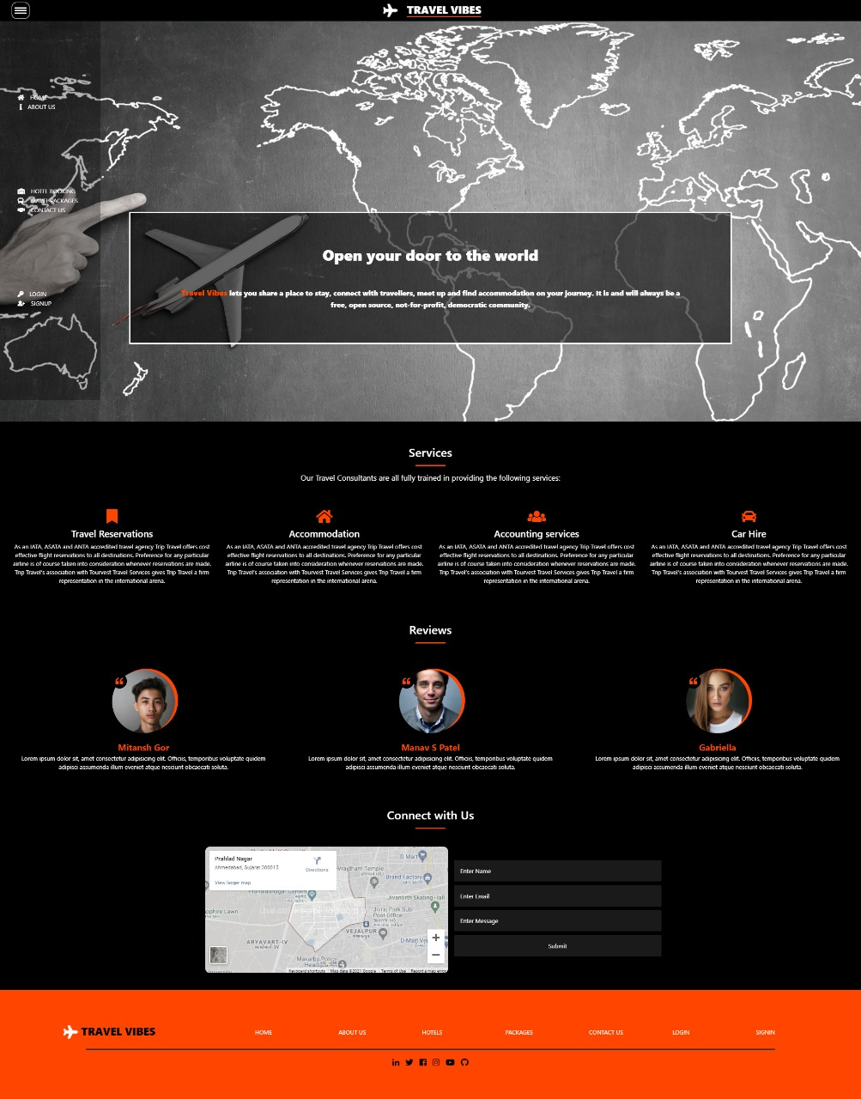
PROJECT EXPLAINATION:-
Travel vibes homepage
WE CREATED HOMEPAGE WHICH CAN BE ACCESSED BY EVERYONE WHO VISITS THE WEBSITE.
WE CREATED ANIMATED LOGO IN THE HEADER AND AN UNIQUE LEFT NAVIGATION BAR.
REVIEWS ARE DIRECTLY ADDED TO THE WEBSITE WHICH ARE CREATED BY THE USERS.
WE CREATED FOOTER WHICH CONNECTS THE USER TO OUR SOCIAL PLATFORMS.

Slide 8
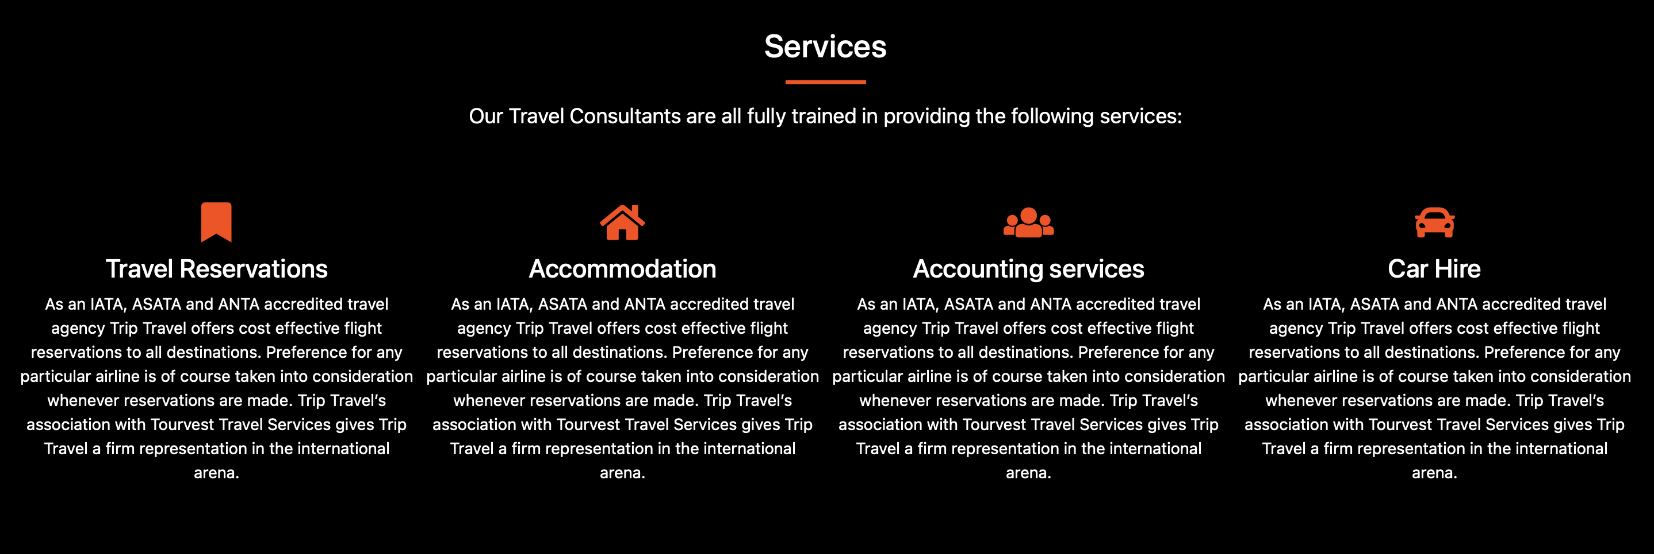
ABOUT US :-
ABOUT US PAGE CREATES A WONDERFUL VIEW OF TRAVEL VIBES WEBPAGE AS IT DESCRIBES THE FACILITIES SUCH AS TRAVEL RESERVATIONS, CAR HIRE SERVICES, ACCOMODATION AND ACCOUNTING SERVICES THAT WE PROVIDE TO OUR CUSTOMERS.

Slide 9
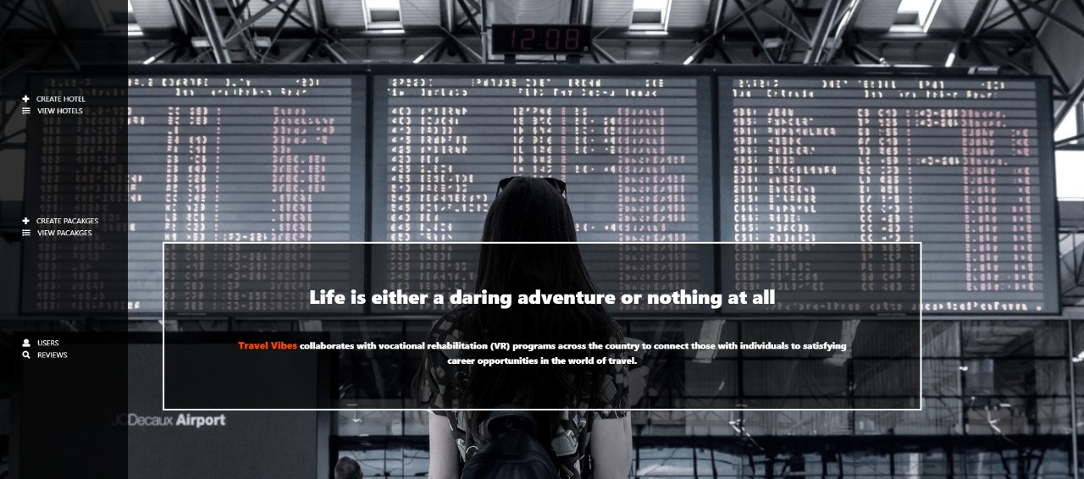
ADMIN MAINPAGE :-
WHEN ADMIN LOGS IN HIS ACCOUNT, THE NAVIGATION BAR CHANGES ACCORDING TO THE ADMIN PAGE.
.

Slide 10
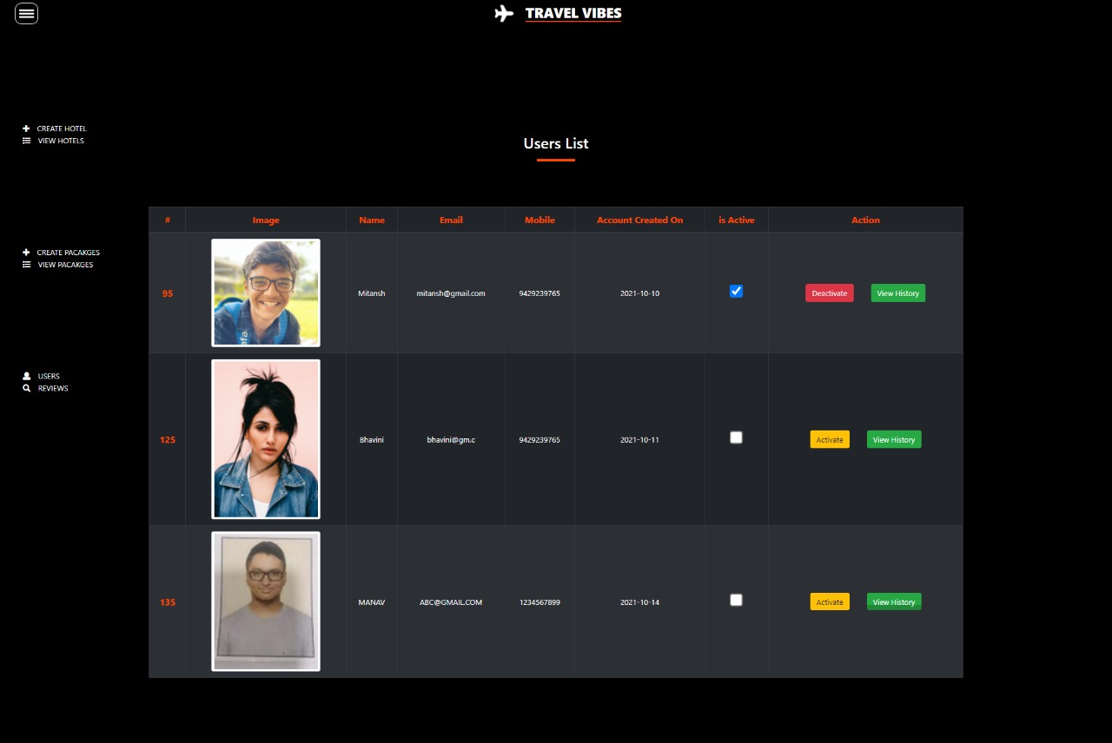
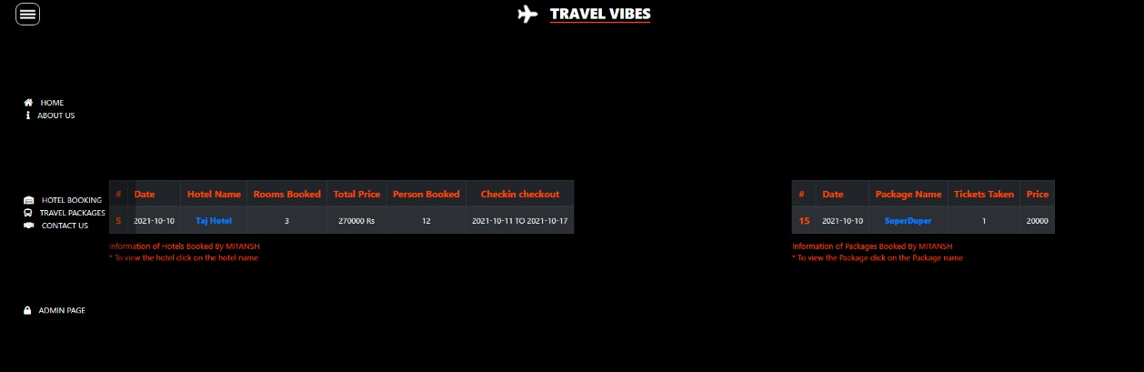
ADMIN CAN ACTIVATE / DE-ACTIVATE THE USER’S PROFILE AND CAN SEE IF THE USERS ARE ACTIVE ON THE WEBSITE OR NOT.
ADMIN CAN SEE THE USERS BOOKIN HISTORY.

Slide 11
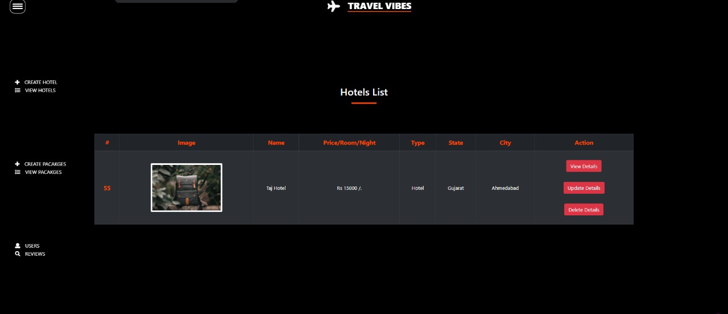
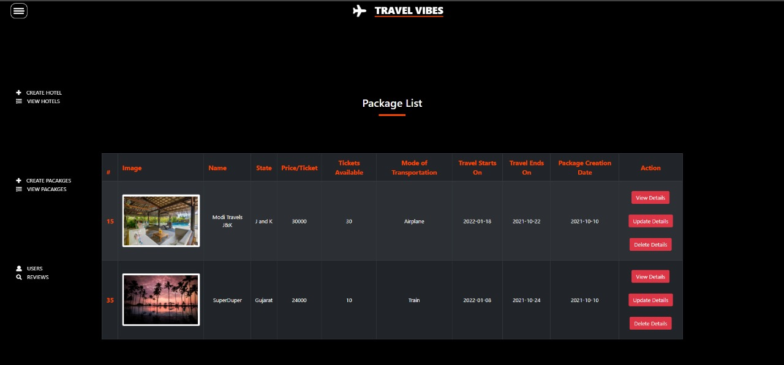
HOTELS LIST HAVING THE FUNCTIONALITY UPDATE, DELETE AND VIEW.
PACKAGES LIST HAVING THE FUNCTIONALITY UPDATE, DELETE AND VIEW.

Slide 12
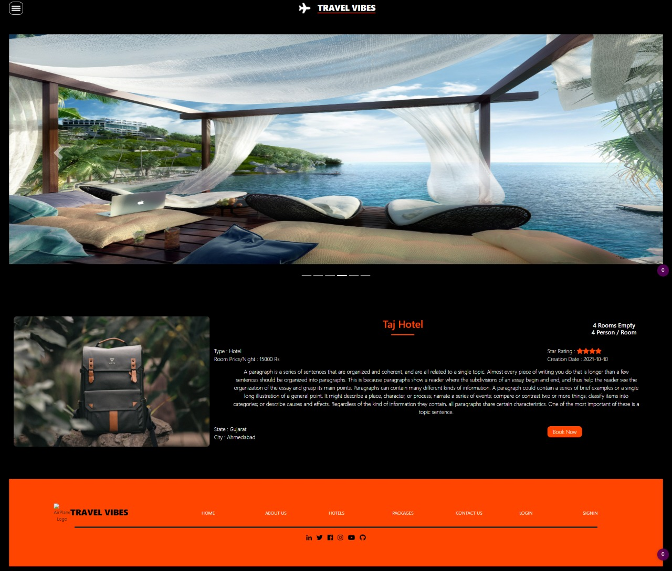
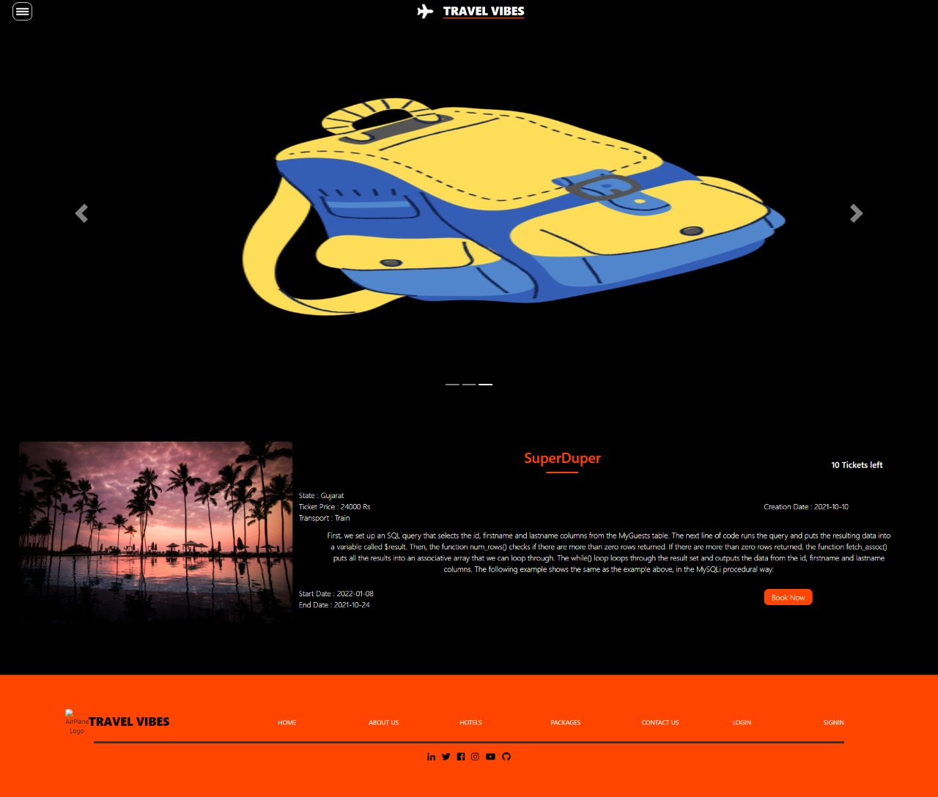
DETAILED INFO OF THE HOTEL :-
DETAILED INFO OF THE PACKAGES :-

Slide 13
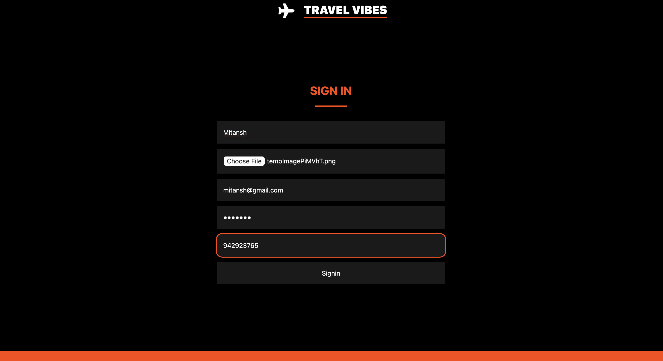
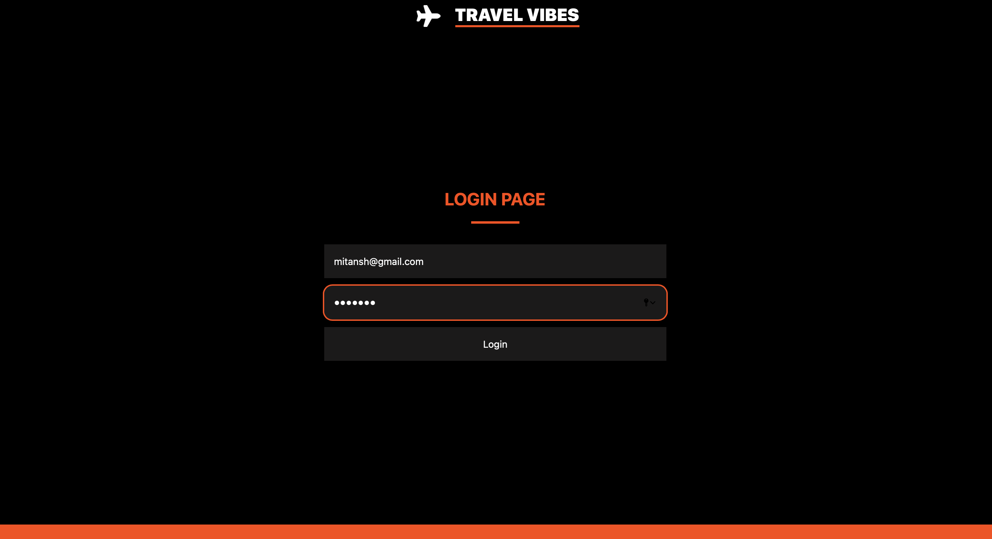
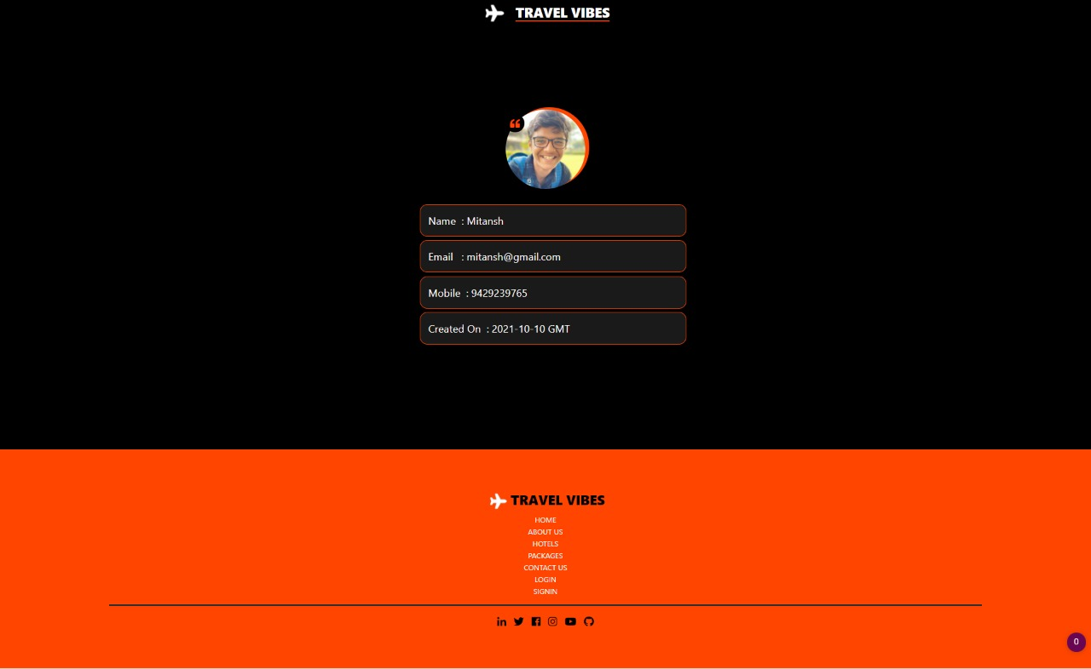
USER SIGN IN / LOG IN :-
USER SIGN IN
USER LOGIN
USER’S CAN SEE THEIR PROFILE AFTER LOGGING IN IN THEIR ACCOUNT

Slide 14
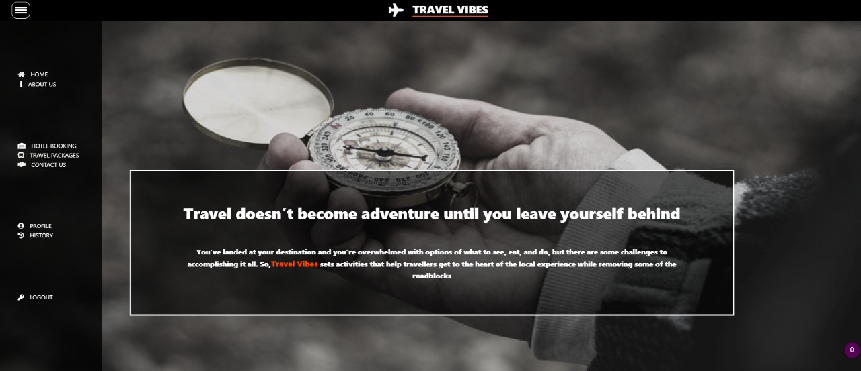
USER PAGE :-
WHEN USER LOGS IN HIS ACCOUNT, THE NAVIGATION BAR CHANGES ACCORDING TO THE USER PAGE.

Slide 15
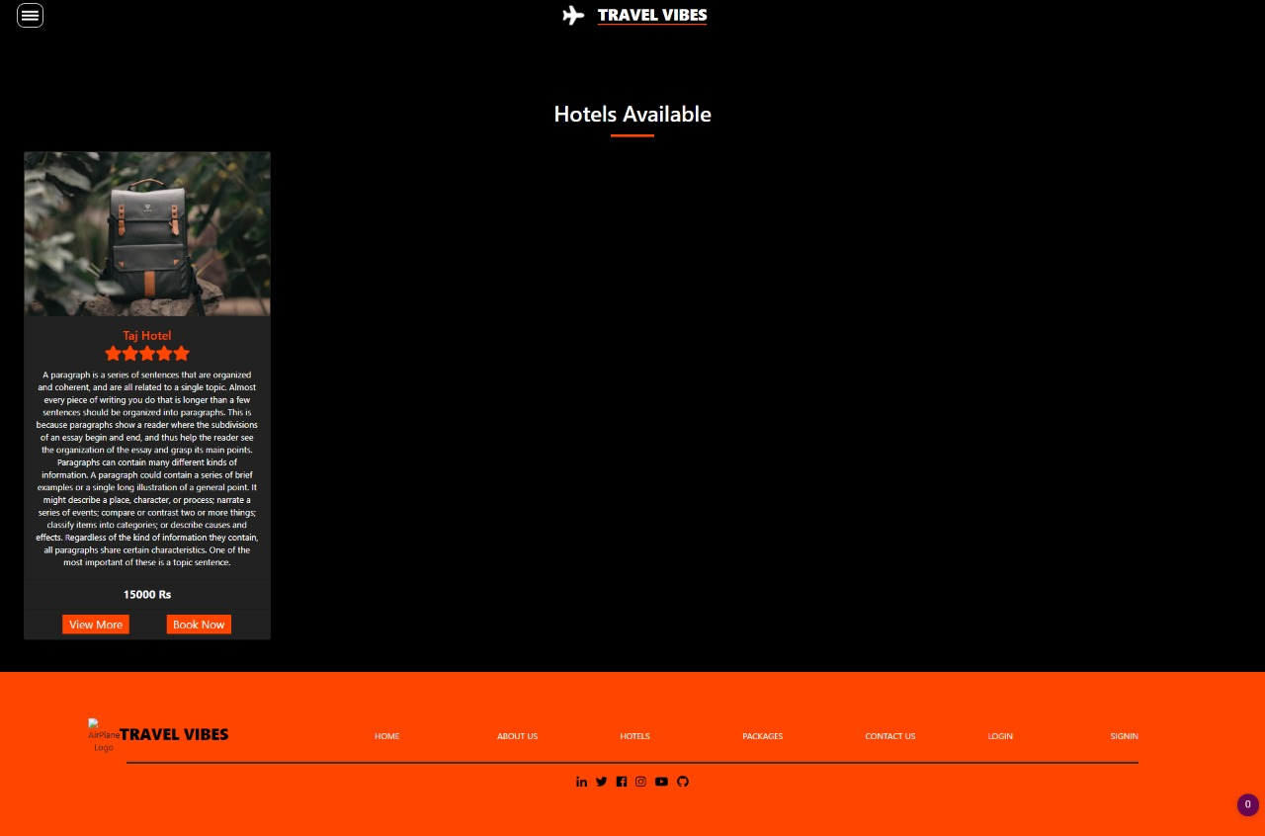
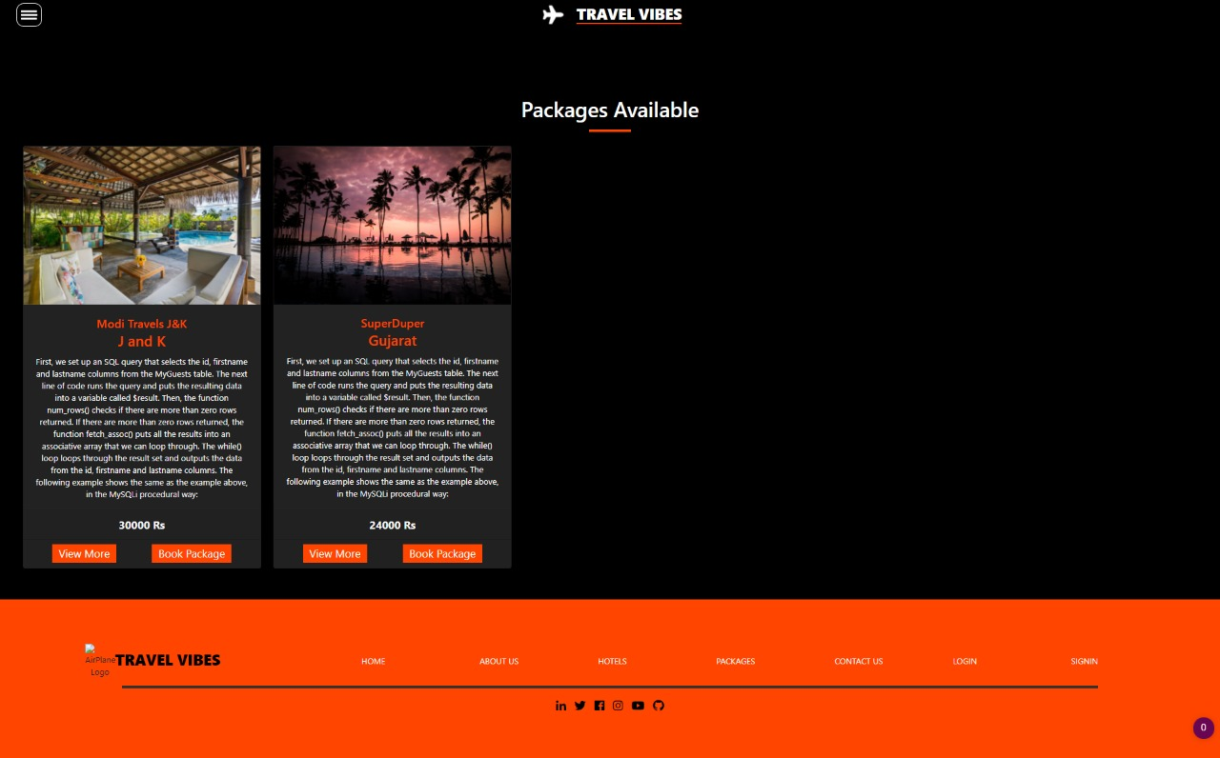
HOTELS AVAILABLE :-
PACKAGES AVAILABLE :-

Slide 16
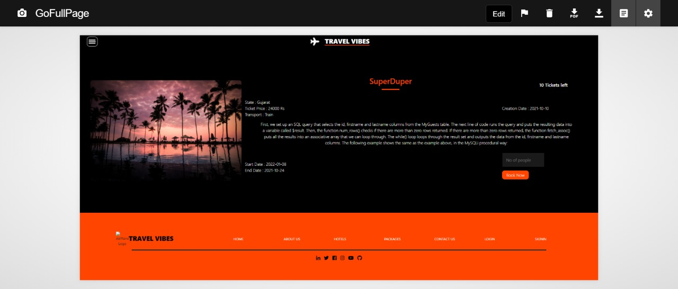
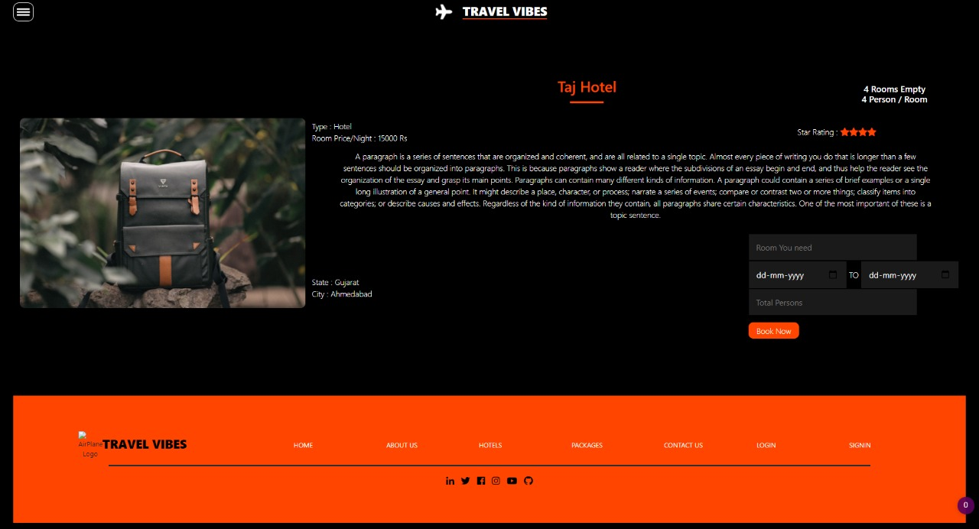
HOTEL BOOKING :-
PACKAGE BOOKING :-

Slide 17
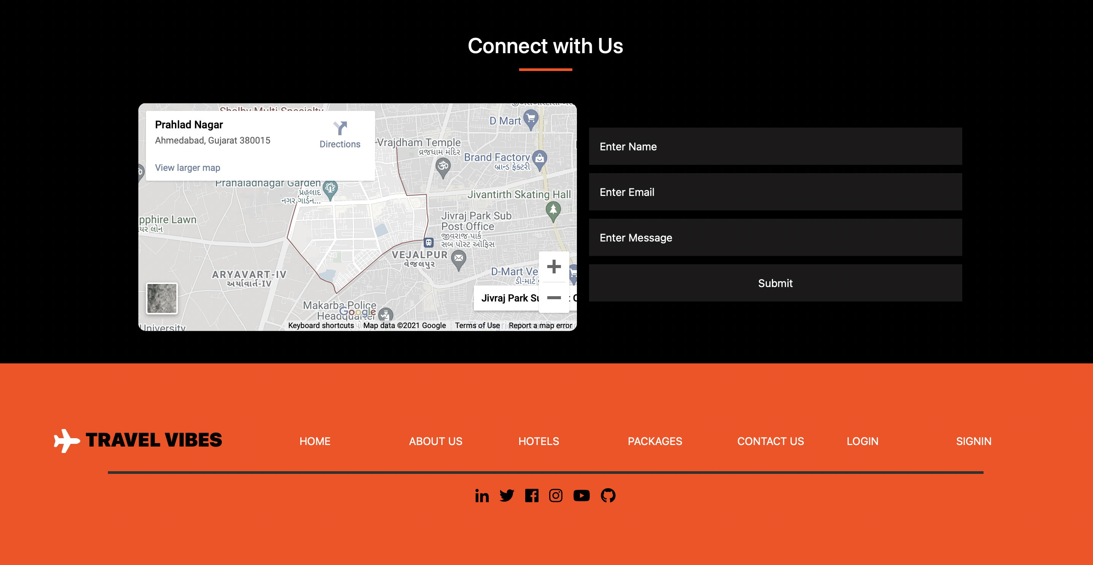
CONTACT US AND SOCIAL MEDIA PLATFORMS
CUSTOMERS CAN FILL UP THE FORM IF THEY HAVE AN QUERY OR NEED SOME SUGGESTIONS OR CAN WALK IN TO OUR OFFICE THROUGH THE GIVEN MAP.
CUSTOMERS CAN CONNECT OR GET NEW UPDATES REGARDING TRAVEL VIBES BY JOINING TRAVEL VIBES SOCIAL MEDIA PLATFORMS.

Slide 18
THANK YOU

